Slide 1
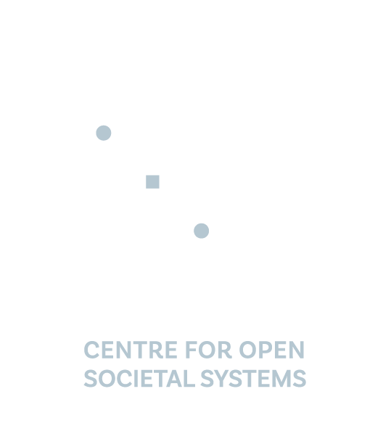
COSS: What we do and How we do it?
From framing problems to securing the future — together with partners.
October 2025

Slide 2






DPI examples
DPI examples
India – UPI → Processes 12+ billion transactions each month, powering payments from street vendors to global cross-border flows.
India – ONDC → An open network for digital commerce, now with 500,000+ merchants, creating alternatives to platform monopolies.
Brazil – Pix → A public payments DPI launched in 2020, now reaching 150M+ people and handling nearly 40% of all retail payments.
Colombia: using X-Road to deliver citizen-orientated digital services
Philippines: using MOSIP to create a national ID system that serves marginalized groups
Uganda: using DHIS2 to respond to COVID-19
India: using Sunbird for capacity building of central government personnel
Why DPGs and DPI?
198+ countries, 100s millions people, billions of transactions - powered by digital public goods
Open, trusted and sovereign
Puts countries in charge of building digital public infra (DPI)
Custom-built for local needs
Faster, lower cost scale
Energize local innovation
Enables transformation, not just digitization
Notes:
speaker notes: When we talk about Digital Public Goods, it’s not an abstract idea anymore — it’s the foundation of how countries are building digital public infrastructure. Today, over 198 countries are using one or more DPGs — from MOSIP for national ID in the Philippines, to Mojaloop in Rwanda for payments, to Sunbird in India for teacher training. These are open, sovereign, and community-owned solutions that allow countries to control their digital future. DHIS2 is powering national health information systems in nearly 70 countries, serving over 3 billion people—that’s 40% of the global population. MOSIP, our digital identity backbone, has issued over 100 million IDs across more than 10 countries.
The benefits are clear — faster, cheaper, and more trusted than proprietary systems, while creating space for local innovators to build. But adoption alone isn’t enough. Moving from pilots to population-scale transformation requires orchestration, alignment, and trust. That’s where COSS comes in. Anchored in IIIT-Bangalore and the EkStep network, we help governments and partners co-create and sustain national digital transformations, ensuring that technology translates into societal outcomes."*

Slide 3
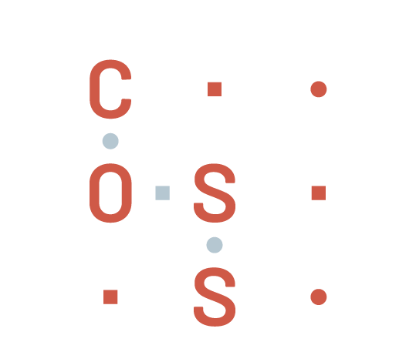
…and what are the challenges to DPI adoption?
Execution
Difficulty translating plans into delivery
“
Trust
No neutral steward ensuring success.
COSS is the neutral orchestrator helping countries co-create DPI from policy to adoption — ensuring accountability, capability, and continuity throughout the journey.
Understanding
Shallow grasp of DPI journey beyond tech.
Expertise
Limited DPI know-how across actors.
Co-ordination
Weak inter-governmental collaboration mechanisms
Ecosystem
Inability to align and support delivery partners.
Frameworks
Absence of guiding structures and repeatable models for collaboration

Slide 4




What differentiates COSS?
Together we design and orchestrate transformation owned by your ecosystem, not prescribed from outside
assist in identifying and detailing out the problem
Our role begins by assisting in identifying and detailing the problem, aligning all actors around a clear purpose.
co-create the DPI solution with ecosystem
With local anchors and global partners, we co-create for population-scale impact—always rooted in societal outcomes
be the not-for-profit stewards
We are a neutral, not-for-profit steward who safeguards openness, privacy, security, sovereignty, and public accountability over private lock-in.
turn experience into action
We bring hard-won experience from global DPI journeys—engineers, policy thinkers, and program leaders who know that lasting societal transformation comes from iteration and learning.
apply knowledge with experience
We carry a repeatable playbook, benchmarked to UN, WB, and DPGA standards, and adapted across Africa, Latin America, and Asia.

Slide 5




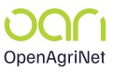
What we do?
COSS brings experience and partners, while ensuring your priorities lead the way
Country Engagements
DPGs
Morocco
Brazil
Sunbird - EkStep
AI4I - Gates
AI4I
Education (teacher training)
Verifiable credentials
AfCFTA
Brazil
OAN - Gates
Verifiable credentials
Joint DPI Centre of Excellence
Currently, COSS has developed deep domain expertise in education, capacity building, agriculture, verifiable credentials and AI for languages.

Slide 6
How do we support societal transformation?
We walk with you knowing transformation is not linear — it is iterative, builds on what came before, and moves forward in waves.
Try
Frame
Try
Frame
Try
Frame
wave 1:
setting the foundation
wave 2:
proving the change
wave 3:
securing the future
Adapt
Adapt
Adapt
Listen
Embed
Listen
Embed
Listen
Embed
what problem are we solving?
why does it matter?
what would success look like?
does the solution work for real users?
what needs to change based on feedback?
is there enough evidence to scale?
how do we reach the whole population?
what ensures long-term funding and governance?
how do we embed lasting capability?

Slide 7
How do we support societal transformation?
Together we bring execution rigour to design and delivery, ensuring transformation moves from vision to scale.
wave 1: setting the foundation
wave 2: proving the change
wave 3: securing the future
Phase 1:
Conception & Scoping
Phase 2: Strategy & Design
Phase 3: Development
Phase 4: Deployment
Phase 5 & 6: Operations & Maintenance
objective
Define public purpose & societal value
Co-create inclusive vision and architecture
Establish governance, architecture, and pilot plans
Test, adapt, and validate through real-world pilots
Expand inclusively with strong governance
(scale)
Institutionalize ownership for the long term
(sustain)
Policy, rollout & technical workshops • Draft blueprint for tech, policy and rollout• Secure funding & partners
Define governance • Build architecture (tech, policy and rollout) • Align ecosystem and partners • Baseline metrics
activities
Early consultations • Map high-value use cases • Initial alignment
Execute pilots • Monitor & refine • Capture lessons
National rollout • Inclusion campaigns • Infrastructure readiness
Transition to national entities • Build capacity • Document learnings
outcomes
Clear PROBLEM and IMPACT definition
BLUEPRINT approved
Pilot plan VALIDATED & resourced
EVIDENCE from pilots to move to scale
Nationwide ADOPTION secured
SUSTAINABILITY validated
Methodology benchmarked to UNDP DPI Safeguards, World Bank DPI Principles, DPGA Guidelines

Slide 8

Models of engagement
COSS walks with you flexibly, ensuring safeguards and credibility whichever model you choose
COSS-led Engagements
Partner-led Engagements
COSS steers the full transformation journey end-to-end
Aligns policy, program, and technology from day one
Provides playbook, safeguards, and program management
Brings in partners as contributors within the COSS framework
best when countries need end-to-end orchestration. Ensures neutral stewardship, credibility, and faster scale.
A global partner (e.g., SI, consulting firm, Cloud Service Provider, other) leads delivery
COSS plays an advisory and neutral role
Relationship: Partner delivers; COSS legitimizes with credibility, methodology, and ecosystem access
Ensures openness, interoperability, and alignment with global standards
best when a delivery partner is already engaged. COSS ensures safeguards, sustainability, and global recognition.

Slide 9
Key discussion points (indicative)
Let’s get started with a few questions to frame priorities and mobilize support!
1. Vision & Sponsorship
What national priorities or problems are you seeking to address through DPI and what impact do you desire?
Who will be the key political and institutional sponsors for this initiative?
How do you see DPI/DPGs fitting into your broader digital strategy?
2. Current readiness
What is the current government policy and does it support current as-is/transformation you are envisioning?
What existing digital infrastructure or systems should be leveraged/factored in?
What challenges have you faced with scale, interoperability, or vendor lock-in?
What early wins or use-cases would build momentum in your context?
3. Resources and capacity
What budgetary commitments or funding pathways are available?
What local institutions, partners, or SIs can be mobilized?
What skills or capacity gaps do you see — policy, technical and programmatic?
Do we have existing structures, frameworks institutions and governance mechanism to implement, manage and evolve this transformation? Or do we need to create new ones?

Slide 10

THANK YOU
GET IN TOUCH
Ramesh MC
mcramesh@coss.org.in
Ekant Tyagi
ekant@coss.org.in
www.coss.org.in

